Slide 1
Distribution Examples
10/06/2021

Slide 2
Binomial Distribution
The binomial distribution is a type of distribution that has two possible outcomes.
Success
Failure
Additionally, they must fit 3 criteria.
Number of observations is fixed.
Each observation is independent.
The probability of success is always the same

Slide 3
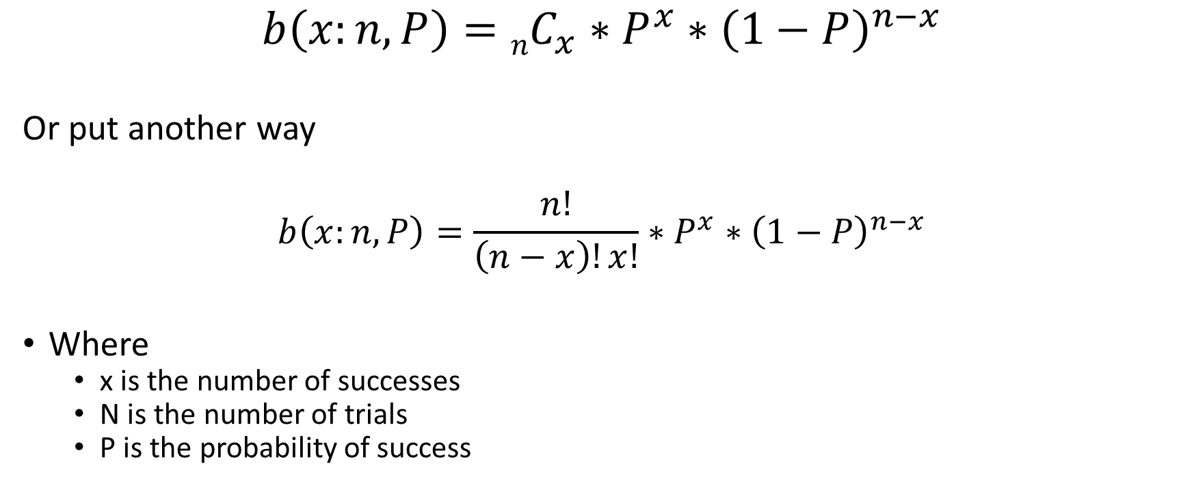
Binomial Distribution
$$b\left(x:n,P\right)=nC_{x}∗P^{x}∗{\left(1−P\right)}^{n−x}$$
Or put another way
$$b\left(x:n,P\right)=\frac{n!}{\left(n−x\right)!x!}∗P^{x}∗{\left(1−P\right)}^{n−x}$$
Where
x is the number of successes
N is the number of trials
P is the probability of success

Slide 4
Binomial Distributions – Do these fit the bill?
A survey in which 1000 participants are asked if they like chocolate.
Recording the status of check engine lights for every car that enters your auto repair shop.
The number of cats in windows on your walk to work.
A carnival game using 6 darts to pop one of 20 darts. 10 successes, and 10 failures.

Slide 5
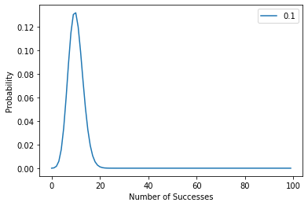
Binomial Distribution - Form

Slide 6
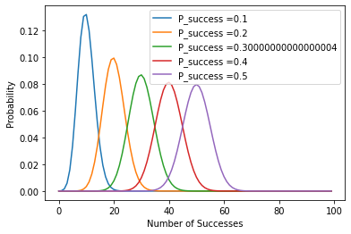
Binomial Distribution

Slide 7
Examples – Simple game
A die is rolled 20 times. If you lands on a 6 you score a point, if you get 5 points you win.
What is the probability of getting exactly 5 points?
What is the probability of getting at least 5 points?

Slide 8
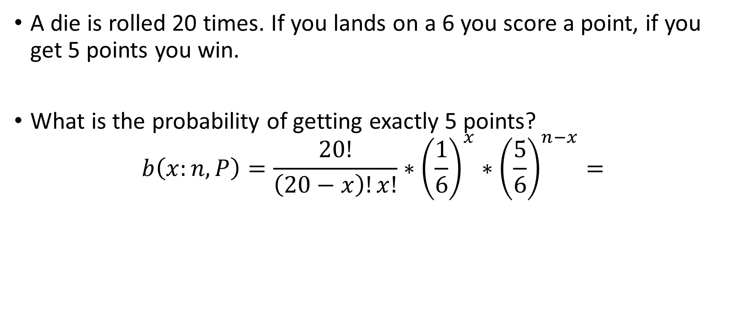
Examples
A die is rolled 20 times. If you lands on a 6 you score a point, if you get 5 points you win.
What is the probability of getting exactly 5 points?
$$b\left(x:n,P\right)=\frac{20!}{\left(20−x\right)!x!}∗{\left(\frac{1}{6}\right)}^{x}∗{\left(\frac{5}{6}\right)}^{n−x}=$$

Slide 9
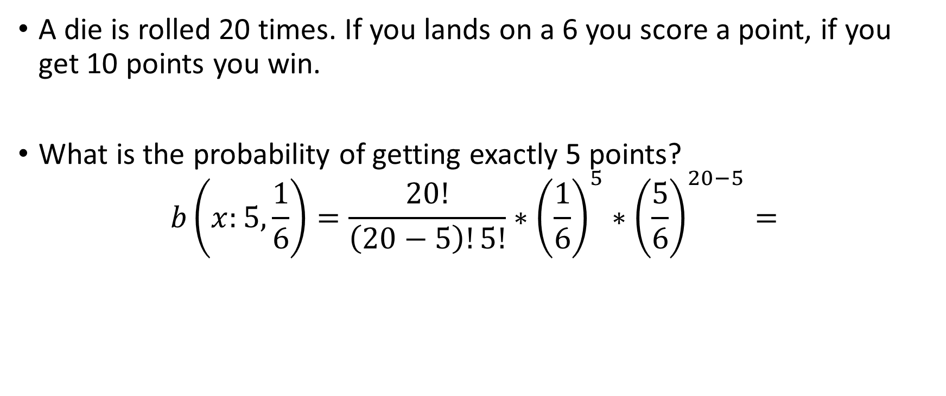
Examples
A die is rolled 20 times. If you lands on a 6 you score a point, if you get 10 points you win.
What is the probability of getting exactly 5 points?
$$b\left(x:5,\frac{1}{6}\right)=\frac{20!}{\left(20−5\right)!5!}∗{\left(\frac{1}{6}\right)}^{5}∗{\left(\frac{5}{6}\right)}^{20−5}=$$

Slide 10
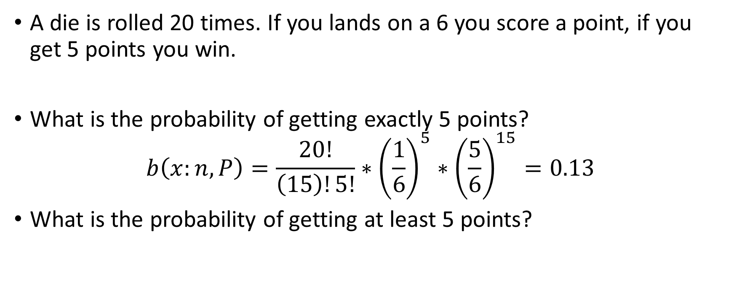
Examples
A die is rolled 20 times. If you lands on a 6 you score a point, if you get 5 points you win.
What is the probability of getting exactly 5 points?
$$b\left(x:n,P\right)=\frac{20!}{\left(15\right)!5!}∗{\left(\frac{1}{6}\right)}^{5}∗{\left(\frac{5}{6}\right)}^{15}=0.13$$
What is the probability of getting at least 5 points?

Slide 11
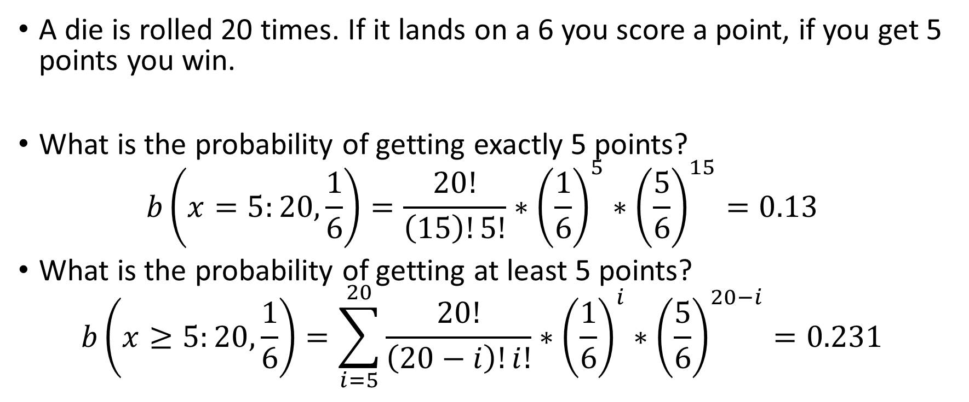
Examples
A die is rolled 20 times. If it lands on a 6 you score a point, if you get 5 points you win.
What is the probability of getting exactly 5 points?
$$b\left(x=5:20,\frac{1}{6}\right)=\frac{20!}{\left(15\right)!5!}∗{\left(\frac{1}{6}\right)}^{5}∗{\left(\frac{5}{6}\right)}^{15}=0.13$$
What is the probability of getting at least 5 points?
$$b\left(x≥5:20,\frac{1}{6}\right)=\sum_{i=5}^{20}{\frac{20!}{\left(20−i\right)!i!}∗{\left(\frac{1}{6}\right)}^{i}∗{\left(\frac{5}{6}\right)}^{20−i}}=0.231$$

Slide 12
100yr Flood Example
You’re told that your city experiences a massive flood from time to time. They refer to it as the 100-year flood. That means that 0.01 flood happen per year.
What is the likelihood of getting exactly one of these floods in the next 30 years?

Slide 13
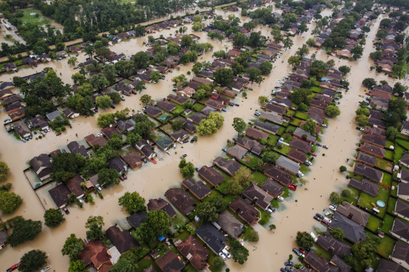
100yr Flood Example

Slide 14

100yr Flood Example
$$b\left(1:30,0.01\right)=\frac{30!}{\left(30−1\right)!1!}∗{0.01}^{1}∗{0.99}^{29}$$

Slide 15

100yr Flood Example
$$b\left(1:30,0.01\right)=\frac{30!}{\left(30−1\right)!1!}∗{0.01}^{1}∗{0.99}^{29}$$
$$b\left(1:30,0.01\right)=\frac{30!}{29!1!}∗0.01∗0.747$$

Slide 16

100yr Flood Example
$$b\left(1:30,0.01\right)=\frac{30!}{\left(30−1\right)!1!}∗{0.01}^{1}∗{0.99}^{29}$$
$$b\left(1:30,0.01\right)=\frac{30!}{29!1!}∗0.01∗0.747$$
$$b\left(1:30,0.01\right)=30∗0.01∗0.747$$

Slide 17
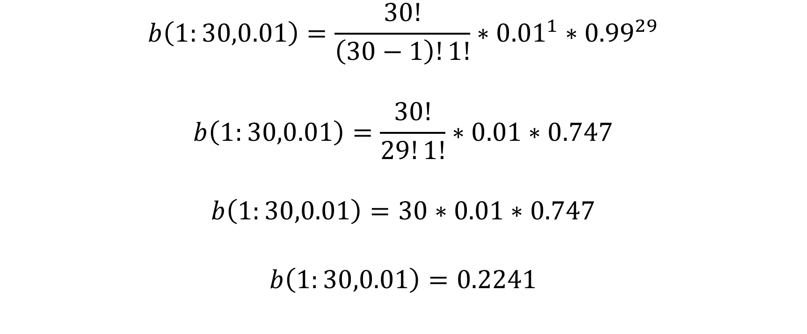
100yr Flood Example
$$b\left(1:30,0.01\right)=\frac{30!}{\left(30−1\right)!1!}∗{0.01}^{1}∗{0.99}^{29}$$
$$b\left(1:30,0.01\right)=\frac{30!}{29!1!}∗0.01∗0.747$$
$$b\left(1:30,0.01\right)=30∗0.01∗0.747$$
$$b\left(1:30,0.01\right)=0.2241$$

Slide 18
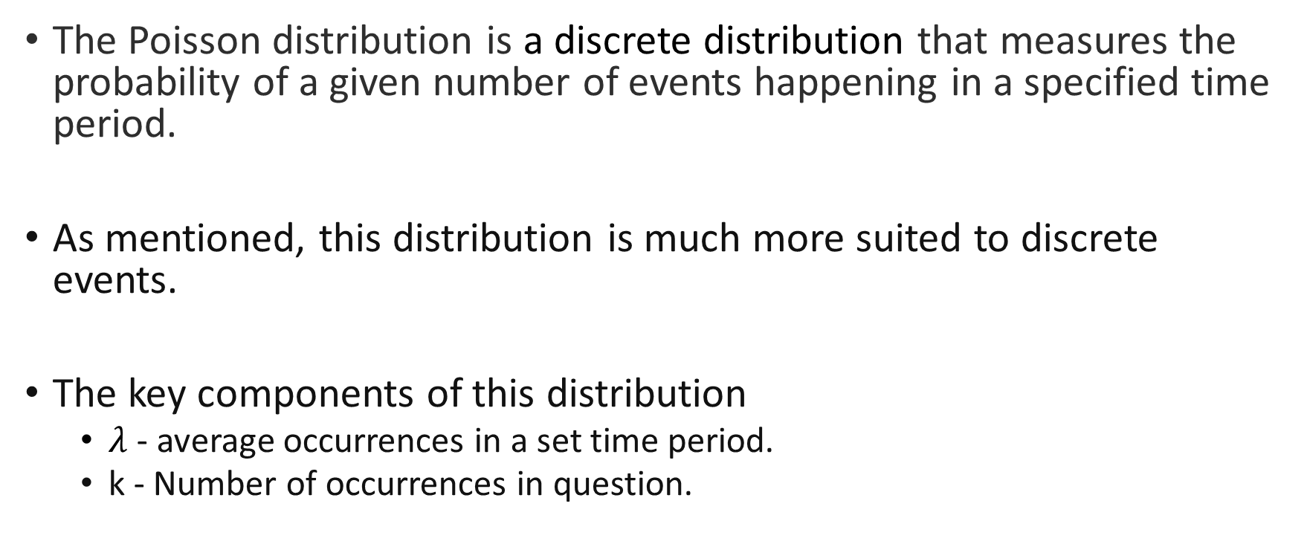
Poisson Distribution
The Poisson distribution is a discrete distribution that measures the probability of a given number of events happening in a specified time period.
As mentioned, this distribution is much more suited to discrete events.
The key components of this distribution
$λ$ - average occurrences in a set time period.
k - Number of occurrences in question.

Slide 19

Poisson Distribution
$$f\left(k:λ\right)=\frac{λ^{k}e^{−λ}}{k!}$$
Where:
$λ$ - average occurrences in a set time period.
k - Number of occurrences in question.

Slide 20
Poisson Distribution
For example, if the average number of people who buy cheeseburgers from a fast-food chain on a Friday night at a single restaurant location is 200, a Poisson distribution can answer questions such as, "What is the probability that more than 300 people will buy burgers?“
Determining the probability of seeing some 2 black cats in one day.
The likelihood of a volcano erupting in the next 10 years.

Slide 21
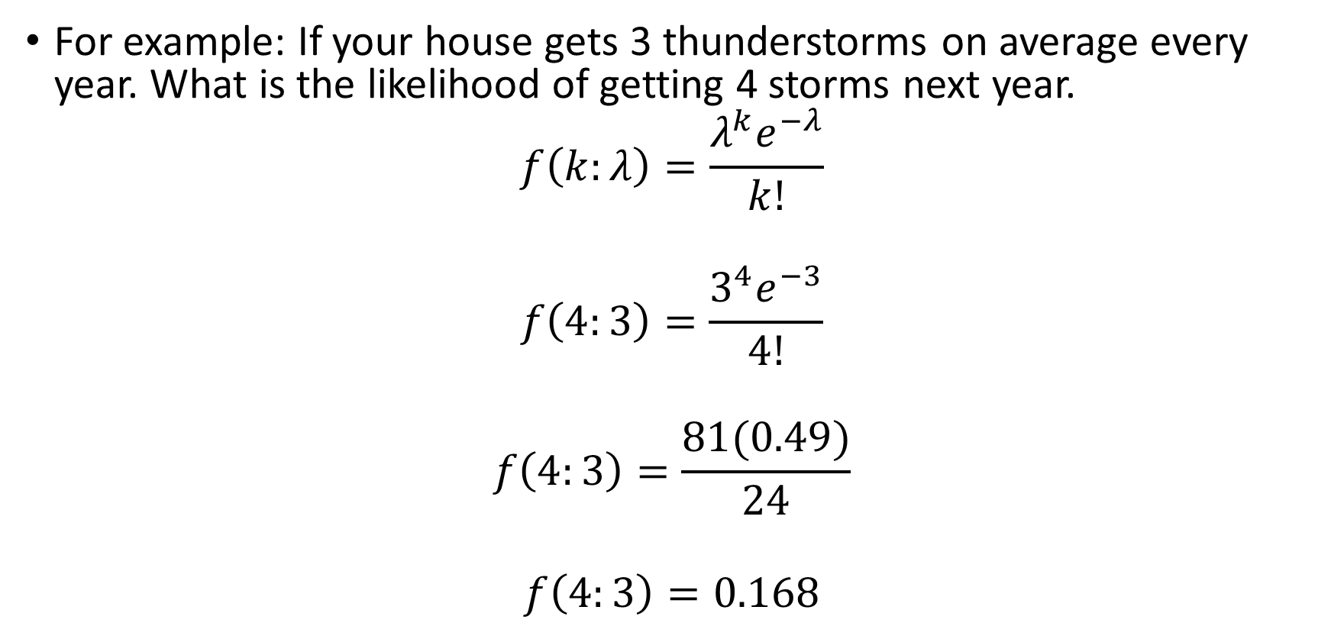
Poisson Distribution
For example: If your house gets 3 thunderstorms on average every year. What is the likelihood of getting 4 storms next year.
$$f\left(k:λ\right)=\frac{λ^{k}e^{−λ}}{k!}$$
$$f\left(4:3\right)=\frac{3^{4}e^{−3}}{4!}$$
$$f\left(4:3\right)=\frac{81(0.49)}{24}$$
$$f\left(4:3\right)=0.168$$

Slide 22
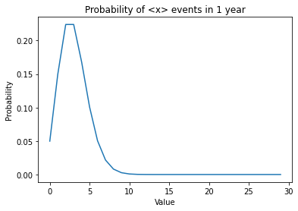

Poisson Distribution
For $λ$ = 3

Slide 23
100yr Flood Example
Consider the 100-year flood example. The chance of getting one of these floods is approximately 0.01 per year.
How should we adjust this value to match the 30-year time frame?
What is the likelihood of getting exactly one of these floods in the next 30 years using the Poisson Distribution?

Slide 24

100yr Flood Example
$$f\left(k:λ\right)=\frac{λ^{k}e^{−λ}}{k!}$$
$$f\left(1:0.3\right)=\frac{{0.3}^{1}e^{−0.3}}{1!}$$
$$f\left(1:0.3\right)=\frac{0.3 ∗0.74}{1}$$
$$f\left(1:0.3\right)=0.2222$$

Slide 25
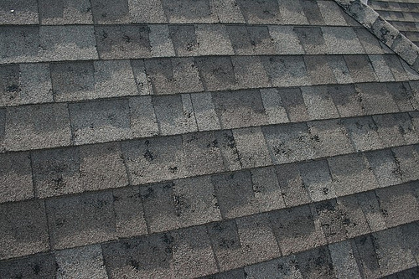
Hailstorm issues – Problem Solving

Slide 26
Hailstorm issues – Problem Solving
Let’s say you want to determine the likelihood of a hailstorm hitting your location

Slide 27
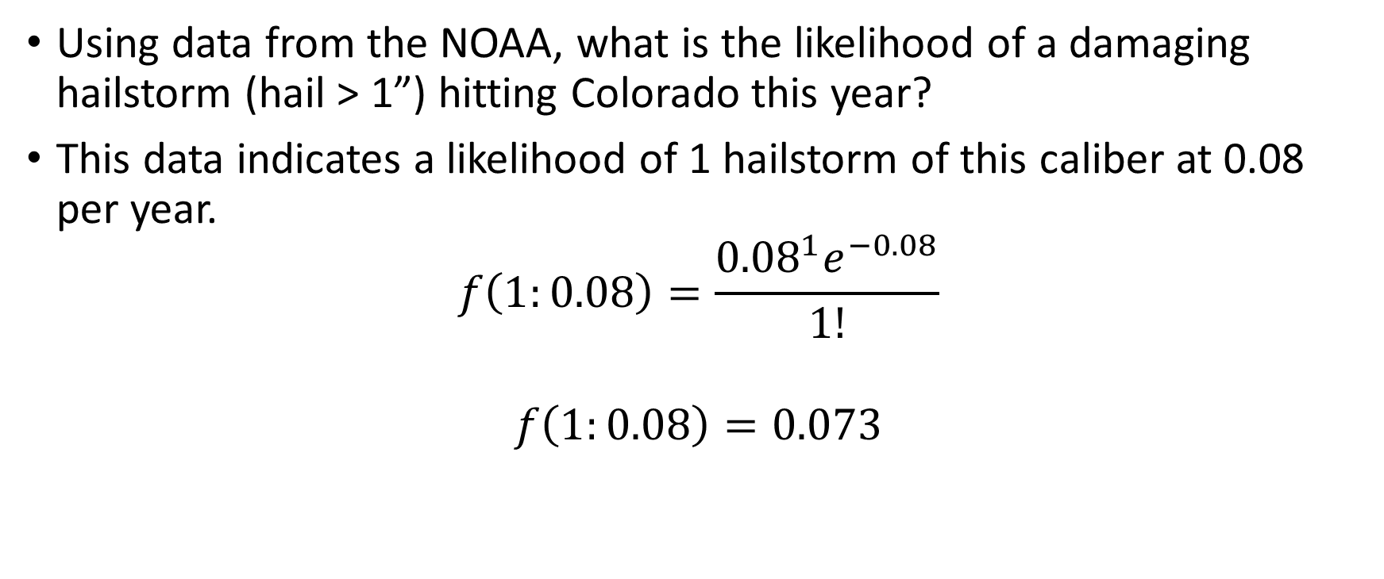
Hail Data Example
Using data from the NOAA, what is the likelihood of a damaging hailstorm (hail > 1”) hitting Colorado this year?
This data indicates a likelihood of 1 hailstorm of this caliber at 0.08 per year.
$$f\left(1:0.08\right)=\frac{{0.08}^{1}e^{−0.08}}{1!}$$
$$f\left(1:0.08\right)=0.073$$

Slide 28
Hail Data Example
What about at least 1 hailstorm?

Slide 29

Hail Data Example
What about at least 1 hailstorm?
$$f\left(0:0.08\right)=\frac{{0.08}^{0}e^{−0.08}}{0!}$$
$$f\left(0:0.08\right)=0.92$$
$$f\left(>1\right)=\left(1−0.92\right)=0.08$$

Slide 30
Hail Data Example
What is the likelihood of having one hailstorm of that size within the next 30 years?

Slide 31

Hail Data Example
How about at least 1 storm in 30 years?
$$f\left(0:2.4\right)=\frac{{2.4}^{0}e^{−2.4}}{0!}$$
$$f\left(0:0.08\right)=0.09$$
$$f\left(>1\right)=\left(1−0.09\right)=0.91$$

Slide 32
Gaussian or Normal Distribution
Normal distribution, also known as the Gaussian distribution, is a probability distribution that is symmetric about the mean.
Also known as the Bell curve.
There are two key components to the normal distribution.
Mean
Variance

Slide 33

Gaussian Distrubtion
$$f\left(x\right)=\frac{1}{σ\sqrt{2π}}e^{{\left(\frac{\left(x−μ\right)}{2σ}\right)}^{2}}$$

Slide 34
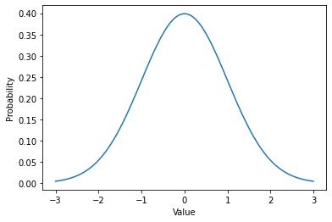
Gaussian Distribution

Slide 35
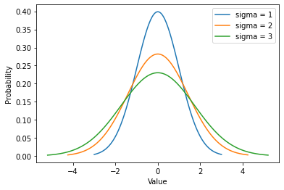
Gaussian Distribution

Slide 36
Campus Example
The health and wellness center on campus records the height of all students that go there. They record the average height on campus to be 5’6” with a standard deviation of 5”.
What is the probability of running into a 5’2” person on campus?

Slide 37

Campus Example
$$f\left(x\right)=\frac{1}{σ\sqrt{2π}}e^{{\left(\frac{\left(x−μ\right)}{2σ}\right)}^{2}}$$
$$f\left(x\right)=\frac{1}{5\sqrt{2π}}e^{{\left(\frac{\left(62−66\right)}{10}\right)}^{2}}$$
$$f\left(x\right)=0.094$$

Slide 38
Item Specification example
What is the probability of finding an out of spec item?
You are told that a machine shop can craft a cylinder you need. While the mean diameter of the cylinders will match the specifications (100mm), you are warned there is a standard deviation in diameter of 1mm.
If you can’t use anything greater than 1.2mm away from your specified mean, what percent of the machined parts can you use?

Slide 39
Item Specification example
In order to accomplish this, we need to do something extra. We want all sizes between 98.8mm and 101.2mm.
How could we accomplish this?

Slide 40
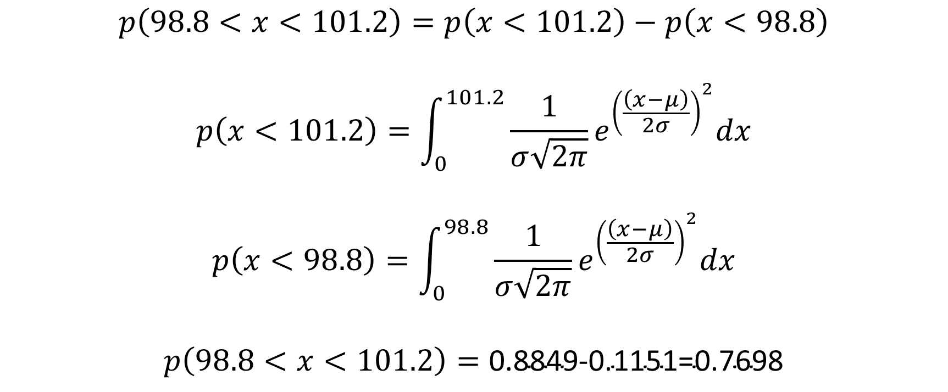
Item Specification example
$$p\left(98.8<x<101.2\right)=p\left(x<101.2\right)−p\left(x<98.8\right)$$
$$p\left(x<101.2\right)=\int_{0}^{101.2}{\frac{1}{σ\sqrt{2π}}e^{{\left(\frac{\left(x−μ\right)}{2σ}\right)}^{2}}dx}$$
$$p\left(x<98.8\right)=\int_{0}^{98.8}{\frac{1}{σ\sqrt{2π}}e^{{\left(\frac{\left(x−μ\right)}{2σ}\right)}^{2}}dx}$$
$$p\left(98.8<x<101.2\right)=\text{0.8849}\text{−}\text{0.115}\text{1=0.7698}$$

Slide 41
Gamma Distributions
10/20/2022

Slide 42

Recap
Previously we discussed the Poisson distribution.
$$f\left(k:λ\right)=\frac{λ^{k}e^{−λ}}{k!}$$
or
$$f\left(k:r∗t\right)=\frac{{(r∗t)}^{k}e^{−(r∗t)}}{k!}$$
Where:
$λ$ - average occurrences in a set time period.
k - Number of occurrences in question.
r – rate of occurrences
t – time investigated

Slide 43
Recap
In that discussion we discussed how we might use it to investigate failure times or inform replacement schedules.
This was the example we did at the end of class about the transister.
In this class we’re going to extend that work by deriving the Gamma distribution. This distribution is often used to determine the r’th time an event will occur.

Slide 44
Gamma Distribution
Distribution of times until the 4th pump fails in a system of pumps that ensure cooling of a nuclear reactor.
Distribution of times until the 3rd transistor failure in the auto-pilot system of a commercial aircraft.
Distribution of times until the 8th airbag in a fleet of cars fails.

Slide 45
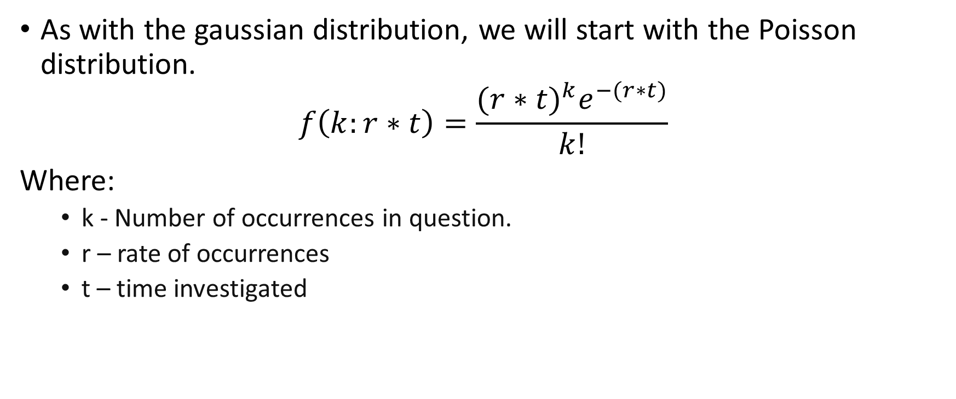
Gamma Distribution - Derivation
As with the gaussian distribution, we will start with the Poisson distribution.
$$f\left(k:r∗t\right)=\frac{{(r∗t)}^{k}e^{−(r∗t)}}{k!}$$
Where:
k - Number of occurrences in question.
r – rate of occurrences
t – time investigated

Slide 46
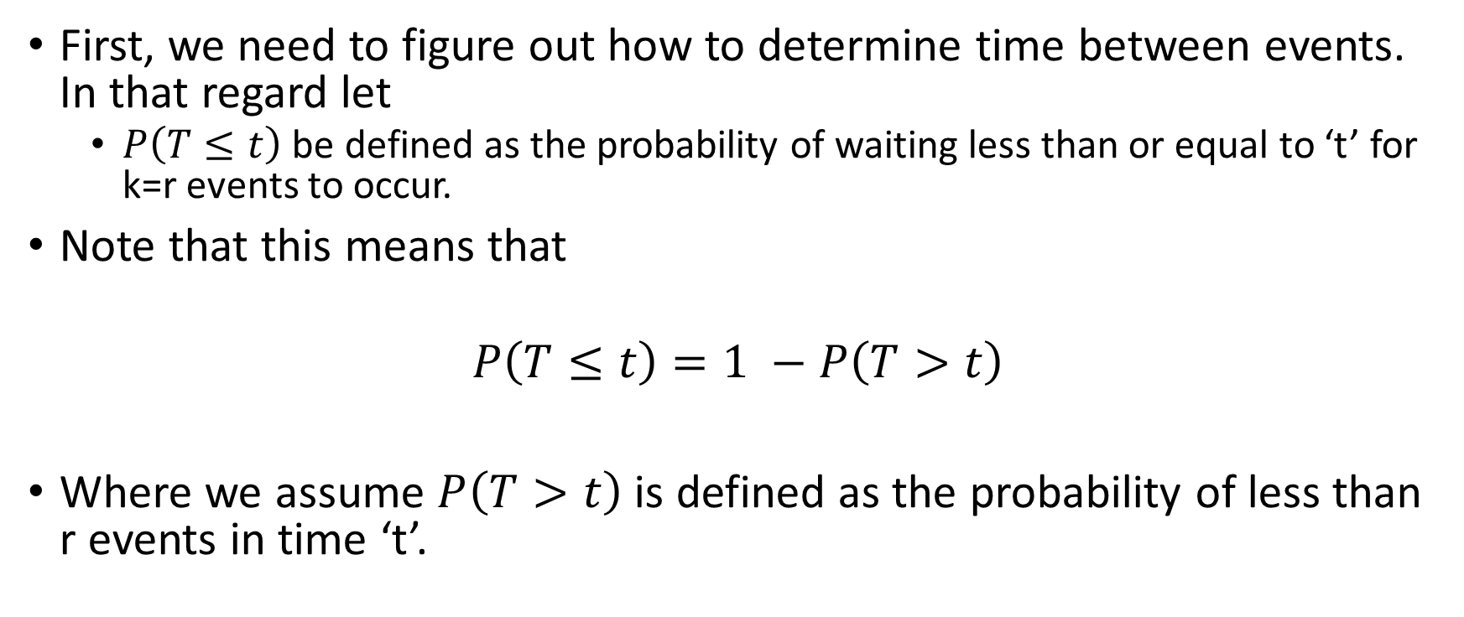
Gamma Distribution - Derivation
First, we need to figure out how to determine time between events. In that regard let
$P\left(T≤t\right)$ be defined as the probability of waiting less than or equal to ‘t’ for k=r events to occur.
Note that this means that
$$P\left(T≤t\right)=1 −P\left(T>t\right)$$
Where we assume $P\left(T>t\right)$ is defined as the probability of less than r events in time ‘t’.

Slide 47

Gamma Distribution - Derivation
$$P\left(T≤t\right)=1 −P\left(T>t\right)$$

Slide 48

Gamma Distribution - Derivation
$$P\left(T≤t\right)=1 −P\left(T>t\right)$$
$$P\left(T≤t\right)=1 −\sum_{k=0}^{k=r−1}{\frac{{(r∗t)}^{k}e^{−(r∗t)}}{k!}}$$
Now please note, $P\left(T≤t\right)$ is a cumulative probability distribution.

Slide 49
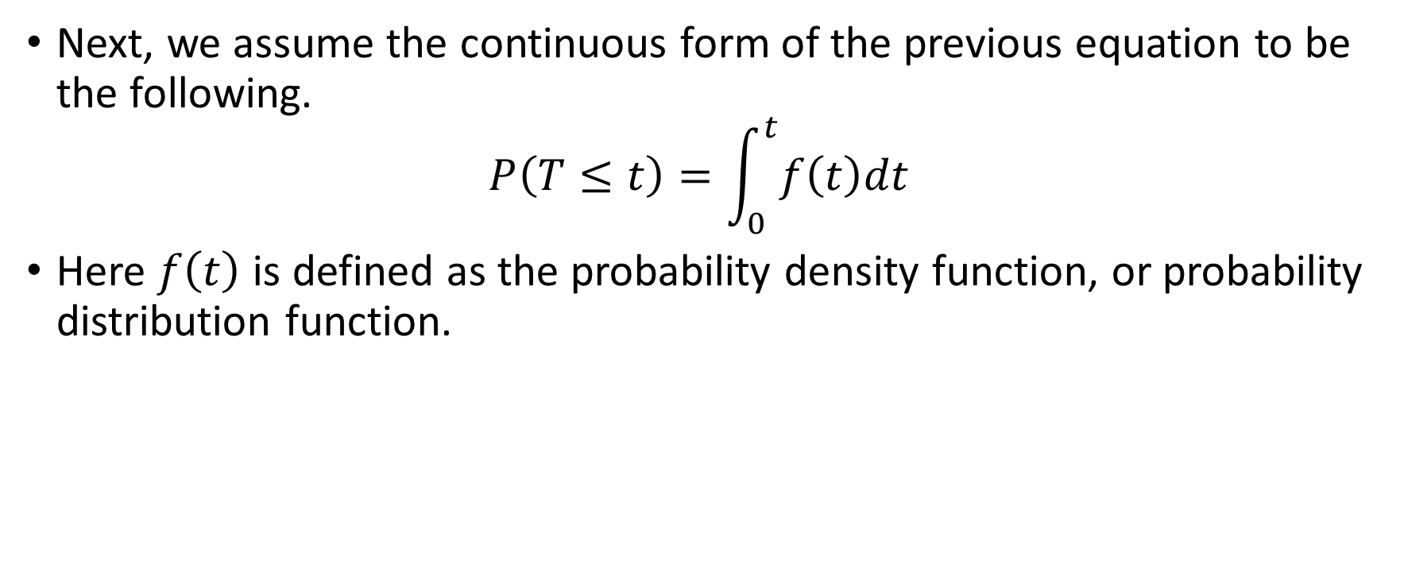
Gamma Distribution – Quick interlude
Next, we assume the continuous form of the previous equation to be the following.
$$P\left(T≤t\right)=\int_{0}^{t}{f\left(t\right)dt}$$
Here $f\left(t\right)$ is defined as the probability density function, or probability distribution function.

Slide 50
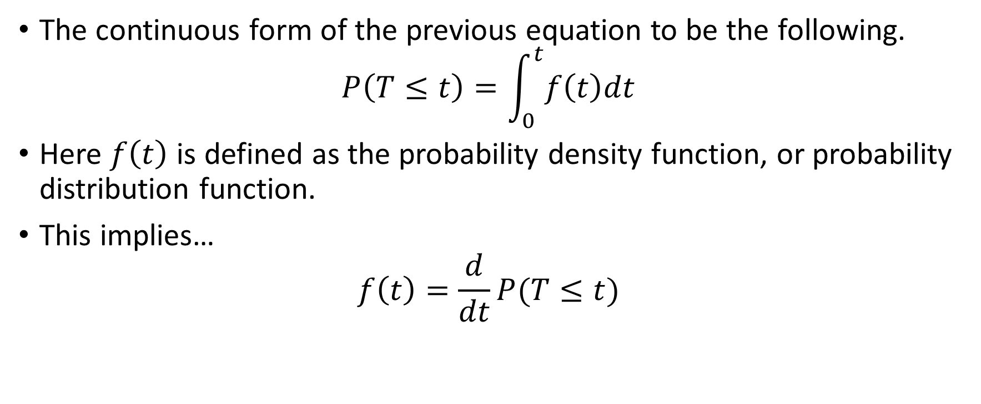
Gamma Distribution - Quick interlude
The continuous form of the previous equation to be the following.
$$P\left(T≤t\right)=\int_{0}^{t}{f\left(t\right)dt}$$
Here $f\left(t\right)$ is defined as the probability density function, or probability distribution function.
This implies…
$$f\left(t\right)=\frac{d}{dt}P(T≤t)$$

Slide 51
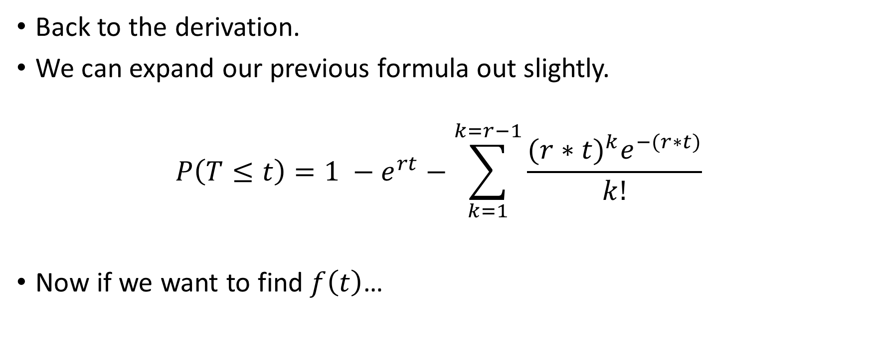
Gamma Distribution - Derivation
Back to the derivation.
We can expand our previous formula out slightly.
$$P\left(T≤t\right)=1 −e^{rt}−\sum_{k=1}^{k=r−1}{\frac{{(r∗t)}^{k}e^{−(r∗t)}}{k!}}$$
Now if we want to find $f\left(t\right)$…

Slide 52
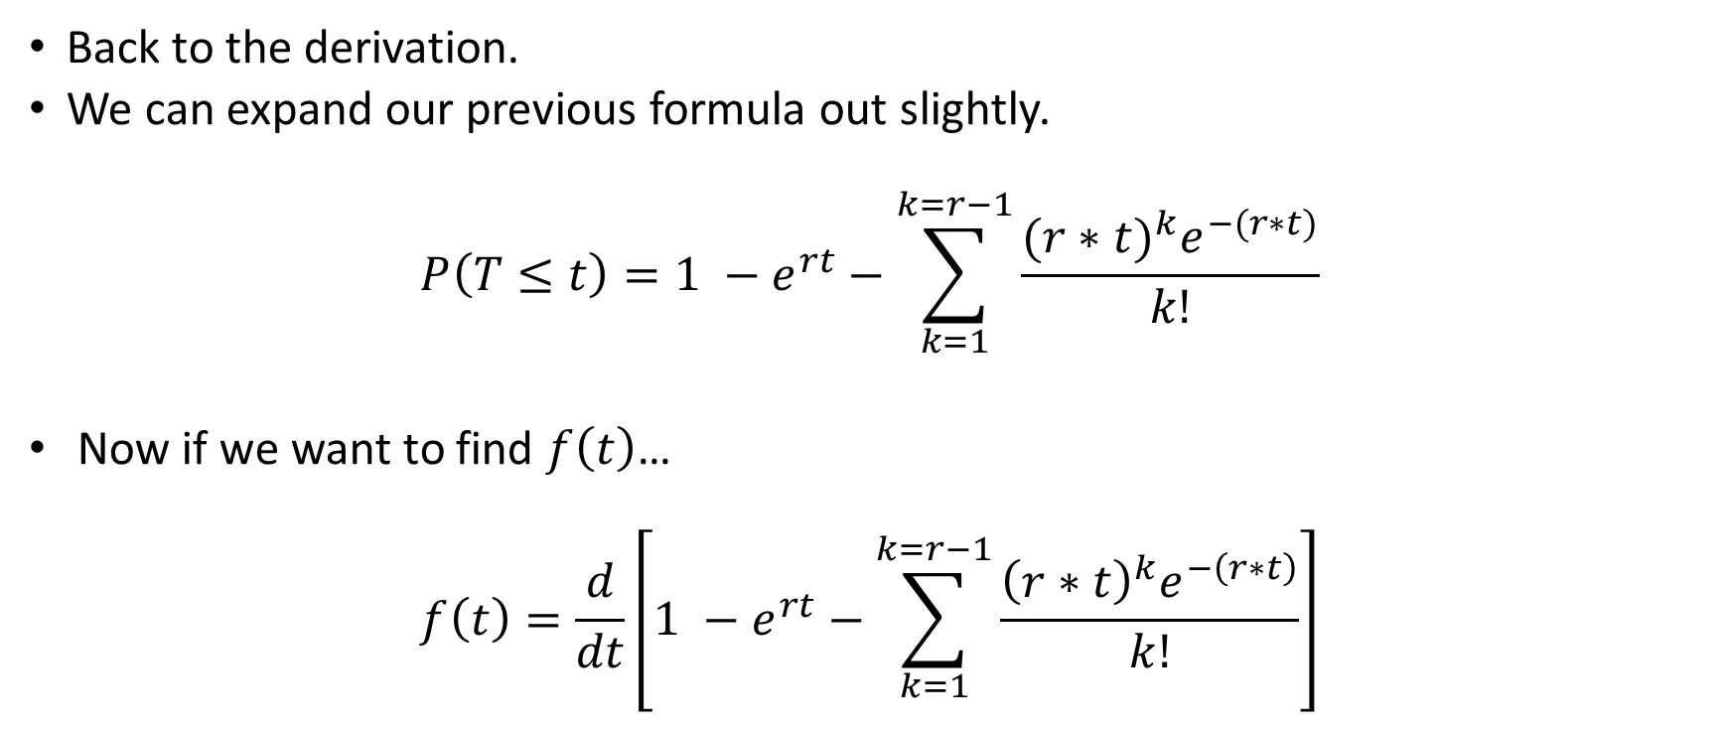
Gamma Distribution - Derivation
Back to the derivation.
We can expand our previous formula out slightly.
$$P\left(T≤t\right)=1 −e^{rt}−\sum_{k=1}^{k=r−1}{\frac{{(r∗t)}^{k}e^{−(r∗t)}}{k!}}$$
Now if we want to find $f\left(t\right)$…
$$f\left(t\right)=\frac{d}{dt}\left[1 −e^{rt}−\sum_{k=1}^{k=r−1}{\frac{{\left(r∗t\right)}^{k}e^{−\left(r∗t\right)}}{k!}}\right]$$

Slide 53

Gamma Distribution - Derivation
$$f\left(t\right)=\frac{d}{dt}\left[1 −e^{rt}−\sum_{k=1}^{k=r−1}{\frac{{\left(r∗t\right)}^{k}e^{−\left(r∗t\right)}}{k!}}\right]$$

Slide 54

Gamma Distribution - Derivation
$$f\left(t\right)=\frac{d}{dt}\left[1 −e^{−rt}−\sum_{k=1}^{k=r−1}{\frac{{\left(r∗t\right)}^{k}e^{−\left(r∗t\right)}}{k!}}\right]$$
$$f\left(t\right)=re^{−rt}−\left\{\frac{d}{dt}\left[\sum_{k=1}^{k=r−1}{\frac{{\left(r∗t\right)}^{k}e^{−\left(r∗t\right)}}{k!}}\right]\right\}$$

Slide 55

Gamma Distribution - Derivation
$$\frac{d}{dt}\left[\sum_{k=1}^{k=r−1}{\frac{{\left(r∗t\right)}^{k}e^{−\left(r∗t\right)}}{k!}}\right]= ?$$

Slide 56

Gamma Distribution - Derivation
$$\frac{d}{dt}\left[\sum_{k=1}^{k=r−1}{\frac{{\left(r∗t\right)}^{k}e^{−\left(r∗t\right)}}{k!}}\right]=\sum_{k=1}^{k=r−1}{\frac{1}{k!}\left\{\frac{d}{dt}\left[(r{t)}^{k}\right]∗e^{−rt}+\frac{d}{dt}\left[e^{−rt}\right]∗(r{t)}^{k}\right\}}$$

Slide 57
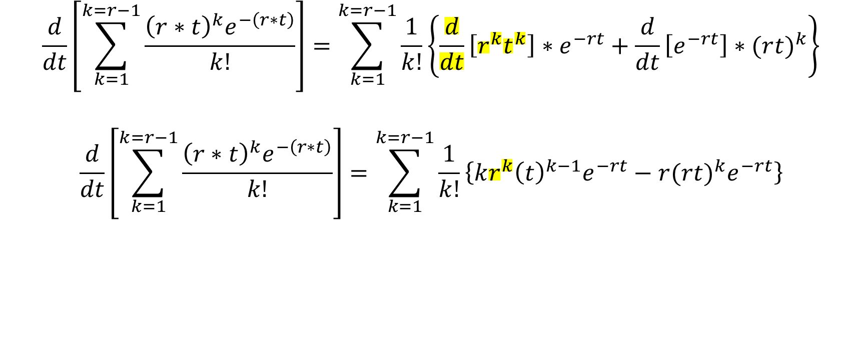
Gamma Distribution - Derivation
$$\frac{d}{dt}\left[\sum_{k=1}^{k=r−1}{\frac{{\left(r∗t\right)}^{k}e^{−\left(r∗t\right)}}{k!}}\right]=\sum_{k=1}^{k=r−1}{\frac{1}{k!}\left\{\frac{d}{dt}\left[r^{k}t^{k}\right]∗e^{−rt}+\frac{d}{dt}\left[e^{−rt}\right]∗(r{t)}^{k}\right\}}$$
$$\frac{d}{dt}\left[\sum_{k=1}^{k=r−1}{\frac{{\left(r∗t\right)}^{k}e^{−\left(r∗t\right)}}{k!}}\right]=\sum_{k=1}^{k=r−1}{\frac{1}{k!}\left\{kr^{k}{\left(t\right)}^{k−1}e^{−rt}−r(r{t)}^{k}e^{−rt}\right\}}$$

Slide 58
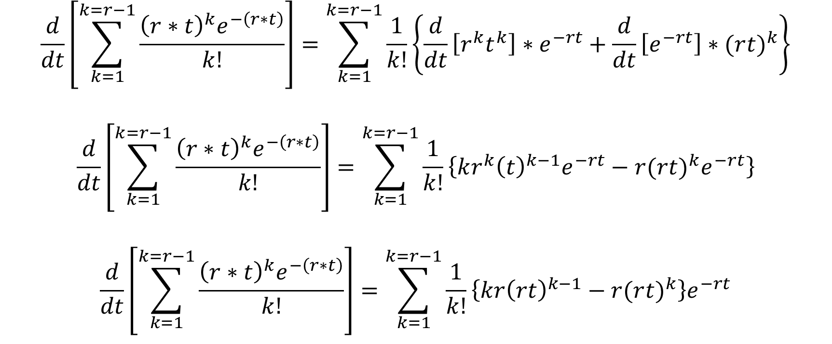
Gamma Distribution - Derivation
$$\frac{d}{dt}\left[\sum_{k=1}^{k=r−1}{\frac{{\left(r∗t\right)}^{k}e^{−\left(r∗t\right)}}{k!}}\right]=\sum_{k=1}^{k=r−1}{\frac{1}{k!}\left\{\frac{d}{dt}\left[r^{k}t^{k}\right]∗e^{−rt}+\frac{d}{dt}\left[e^{−rt}\right]∗(r{t)}^{k}\right\}}$$
$$\frac{d}{dt}\left[\sum_{k=1}^{k=r−1}{\frac{{\left(r∗t\right)}^{k}e^{−\left(r∗t\right)}}{k!}}\right]=\sum_{k=1}^{k=r−1}{\frac{1}{k!}\left\{k{r^{k}\left(t\right)}^{k−1}e^{−rt}−r(r{t)}^{k}e^{−rt}\right\}}$$
$$\frac{d}{dt}\left[\sum_{k=1}^{k=r−1}{\frac{{\left(r∗t\right)}^{k}e^{−\left(r∗t\right)}}{k!}}\right]=\sum_{k=1}^{k=r−1}{\frac{1}{k!}\left\{kr{\left(rt\right)}^{k−1}−r(r{t)}^{k}\right\}e^{−rt}}$$

Slide 59

Gamma Distribution - Derivation
$$\frac{d}{dt}\left[\sum_{k=1}^{k=r−1}{\frac{{\left(r∗t\right)}^{k}e^{−\left(r∗t\right)}}{k!}}\right]=\sum_{k=1}^{k=r−1}{\frac{1}{k!}\left\{k{\left(rt\right)}^{k−1}−(r{t)}^{k}\right\}{re}^{−rt}}$$

Slide 60
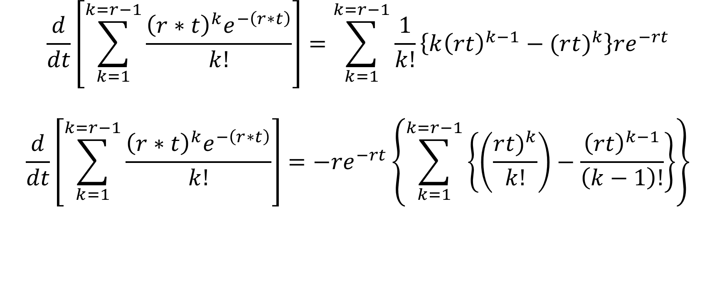
Gamma Distribution - Derivation
$$\frac{d}{dt}\left[\sum_{k=1}^{k=r−1}{\frac{{\left(r∗t\right)}^{k}e^{−\left(r∗t\right)}}{k!}}\right]=\sum_{k=1}^{k=r−1}{\frac{1}{k!}\left\{k{\left(rt\right)}^{k−1}−(r{t)}^{k}\right\}{re}^{−rt}}$$
$$\frac{d}{dt}\left[\sum_{k=1}^{k=r−1}{\frac{{\left(r∗t\right)}^{k}e^{−\left(r∗t\right)}}{k!}}\right]={−re}^{−rt}\left\{\sum_{k=1}^{k=r−1}{\left\{\left(\frac{r{t)}^{k}}{k!}\right)−\frac{{\left(rt\right)}^{k−1}}{\left(k−1\right)!}\right\}}\right\}$$

Slide 61

Gamma Distribution - Derivation
$$\left\{\sum_{k=1}^{k=r−1}{\left\{\left(\frac{(r{t)}^{k}}{k!}\right)−\frac{{\left(rt\right)}^{k−1}}{\left(k−1\right)!}\right\}}\right\}=\left[rt −1\right]+\left[\frac{{\left(rt\right)}^{2}}{2} −rt\right]+$$

Slide 62

Gamma Distribution - Derivation
$$\left\{\sum_{k=1}^{k=r−1}{\left\{\left(\frac{(r{t)}^{k}}{k!}\right)−\frac{{\left(rt\right)}^{k−1}}{\left(k−1\right)!}\right\}}\right\}=\left[\frac{rt}{1!} −1\right]+\left[\frac{{\left(rt\right)}^{2}}{2!} −rt\right]+ \left[\frac{{\left(rt\right)}^{3}}{3!} −\frac{{\left(rt\right)}^{2}}{2!}\right]$$

Slide 63

Gamma Distribution - Derivation
$$\left\{\sum_{k=1}^{k=r−1}{\left\{\left(\frac{(r{t)}^{k}}{k!}\right)−\frac{{\left(rt\right)}^{k−1}}{\left(k−1\right)!}\right\}}\right\}=\left[\frac{rt}{1!} −1\right]+\left[\frac{{\left(rt\right)}^{2}}{2!} −rt\right]+ \left[\frac{{\left(rt\right)}^{3}}{3!} −\frac{{\left(rt\right)}^{2}}{2!}\right]+ \left[\frac{{\left(rt\right)}^{4}}{4!} −\frac{{\left(rt\right)}^{3}}{3!}\right]$$

Slide 64
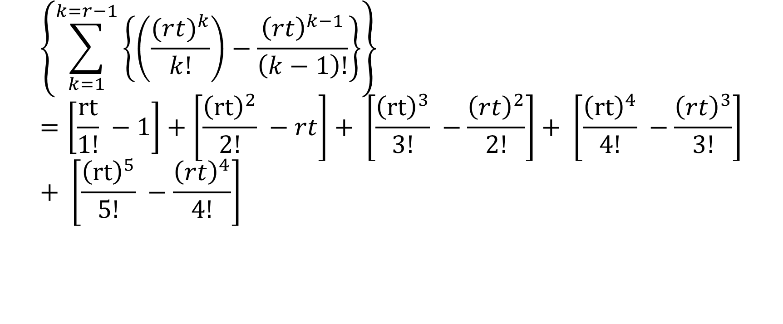
Gamma Distribution - Derivation
$$\left\{\sum_{k=1}^{k=r−1}{\left\{\left(\frac{(r{t)}^{k}}{k!}\right)−\frac{{\left(rt\right)}^{k−1}}{\left(k−1\right)!}\right\}}\right\}=\left[\frac{rt}{1!} −1\right]+\left[\frac{{\left(rt\right)}^{2}}{2!} −rt\right]+ \left[\frac{{\left(rt\right)}^{3}}{3!} −\frac{{\left(rt\right)}^{2}}{2!}\right]+ \left[\frac{{\left(rt\right)}^{4}}{4!} −\frac{{\left(rt\right)}^{3}}{3!}\right]+ \left[\frac{{\left(rt\right)}^{5}}{5!} −\frac{{\left(rt\right)}^{4}}{4!}\right]$$

Slide 65
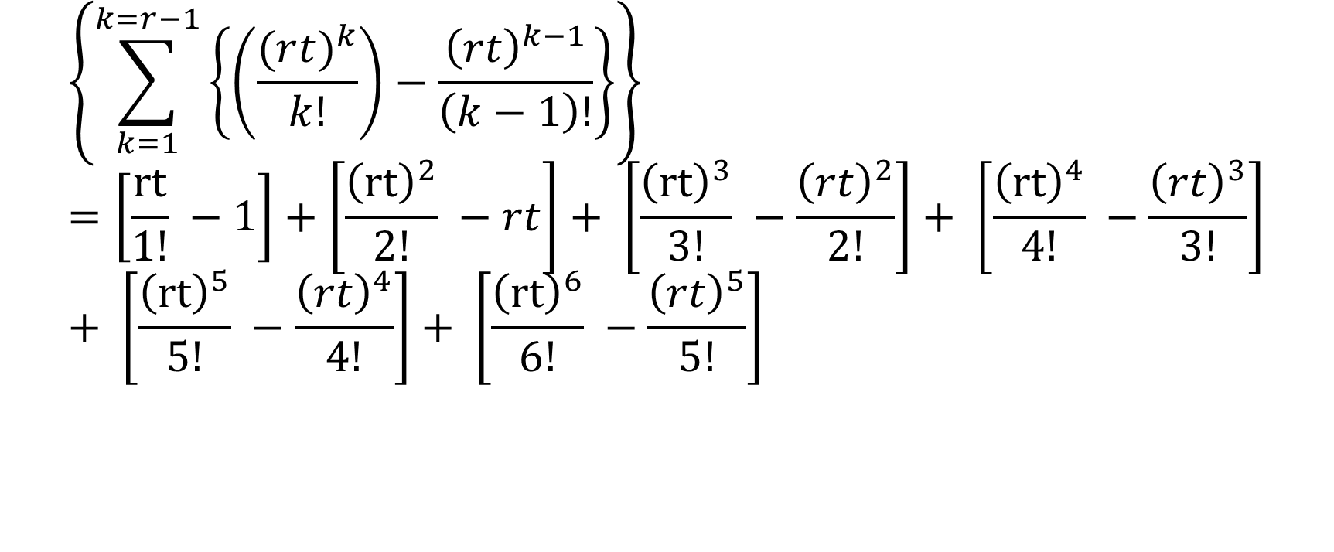
Gamma Distribution - Derivation
$$\left\{\sum_{k=1}^{k=r−1}{\left\{\left(\frac{(r{t)}^{k}}{k!}\right)−\frac{{\left(rt\right)}^{k−1}}{\left(k−1\right)!}\right\}}\right\}=\left[\frac{rt}{1!} −1\right]+\left[\frac{{\left(rt\right)}^{2}}{2!} −rt\right]+ \left[\frac{{\left(rt\right)}^{3}}{3!} −\frac{{\left(rt\right)}^{2}}{2!}\right]+ \left[\frac{{\left(rt\right)}^{4}}{4!} −\frac{{\left(rt\right)}^{3}}{3!}\right]+ \left[\frac{{\left(rt\right)}^{5}}{5!} −\frac{{\left(rt\right)}^{4}}{4!}\right]+ \left[\frac{{\left(rt\right)}^{6}}{6!} −\frac{{\left(rt\right)}^{5}}{5!}\right]$$

Slide 66
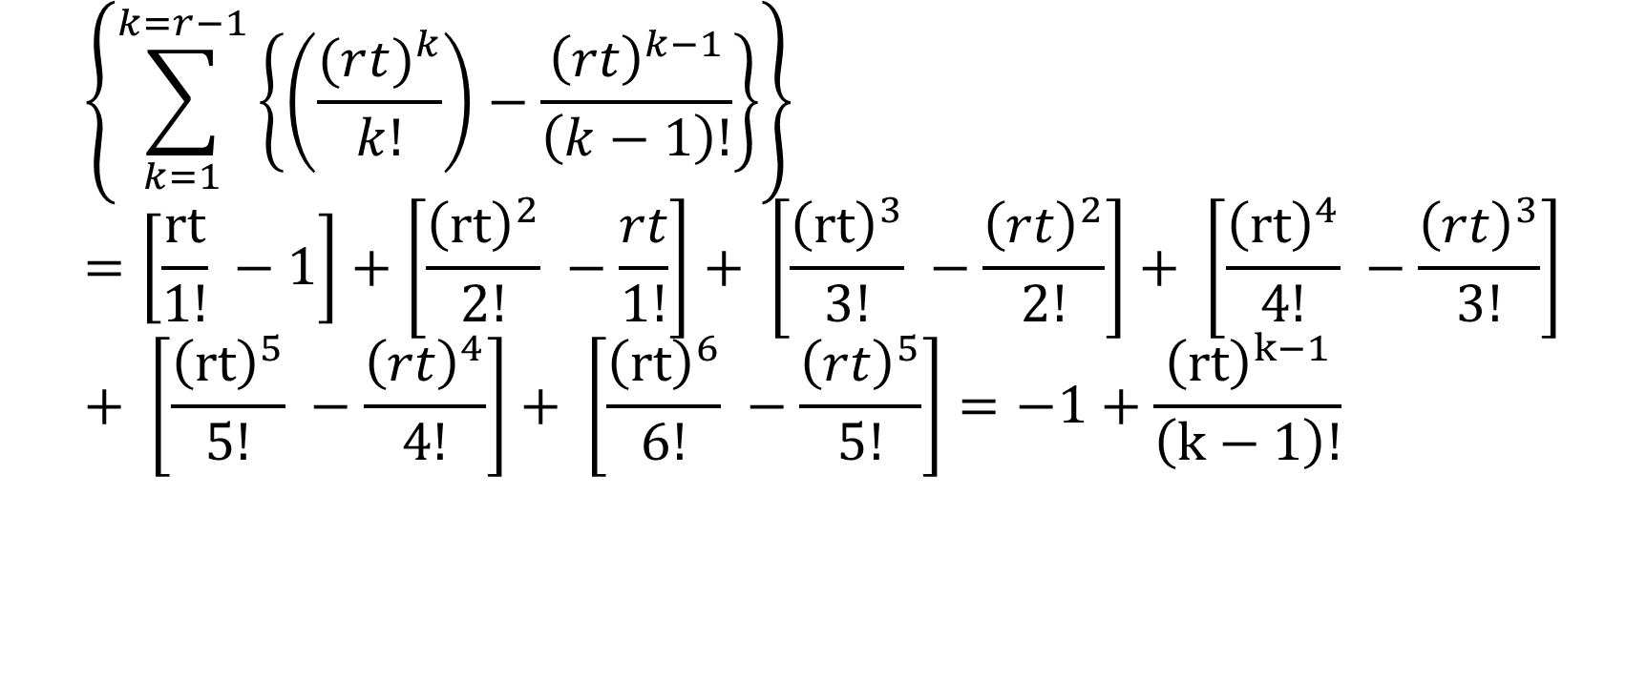
Gamma Distribution - Derivation
$$\left\{\sum_{k=1}^{k=r−1}{\left\{\left(\frac{(r{t)}^{k}}{k!}\right)−\frac{{\left(rt\right)}^{k−1}}{\left(k−1\right)!}\right\}}\right\}=\left[\frac{rt}{1!} −1\right]+\left[\frac{{\left(rt\right)}^{2}}{2!} −\frac{rt}{1!}\right]+ \left[\frac{{\left(rt\right)}^{3}}{3!} −\frac{{\left(rt\right)}^{2}}{2!}\right]+ \left[\frac{{\left(rt\right)}^{4}}{4!} −\frac{{\left(rt\right)}^{3}}{3!}\right]+ \left[\frac{{\left(rt\right)}^{5}}{5!} −\frac{{\left(rt\right)}^{4}}{4!}\right]+ \left[\frac{{\left(rt\right)}^{6}}{6!} −\frac{{\left(rt\right)}^{5}}{5!}\right]=−1+\frac{{\left(rt\right)}^{k−1}}{\left(k−1\right)!}$$

Slide 67
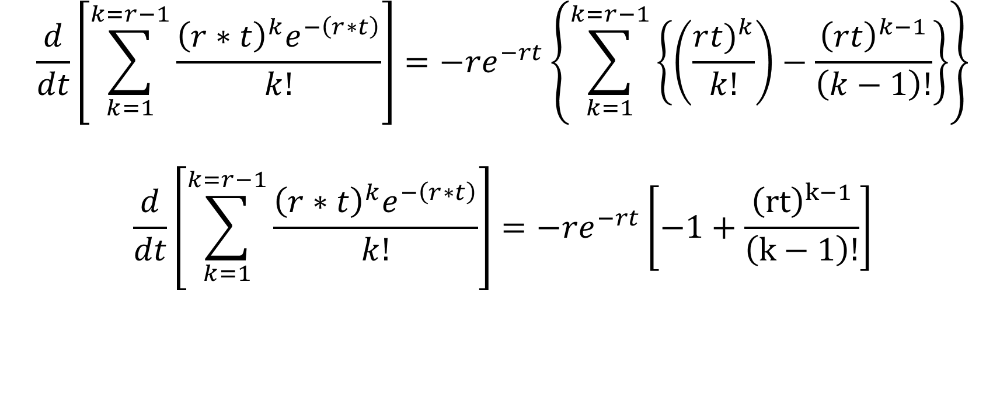
Gamma Distribution - Derivation
$$\frac{d}{dt}\left[\sum_{k=1}^{k=r−1}{\frac{{\left(r∗t\right)}^{k}e^{−\left(r∗t\right)}}{k!}}\right]={−re}^{−rt}\left\{\sum_{k=1}^{k=r−1}{\left\{\left(\frac{r{t)}^{k}}{k!}\right)−\frac{{\left(rt\right)}^{k−1}}{\left(k−1\right)!}\right\}}\right\}$$
$$\frac{d}{dt}\left[\sum_{k=1}^{k=r−1}{\frac{{\left(r∗t\right)}^{k}e^{−\left(r∗t\right)}}{k!}}\right]={−re}^{−rt}\left[−1+\frac{{\left(rt\right)}^{k−1}}{\left(k−1\right)!}\right]$$

Slide 68

Gamma Distribution - Derivation
$$f\left(t\right)=re^{−rt}−\left\{\frac{d}{dt}\left[\sum_{k=1}^{k=r−1}{\frac{{\left(r∗t\right)}^{k}e^{−\left(r∗t\right)}}{k!}}\right]\right\}$$
$$\frac{d}{dt}\left[\sum_{k=1}^{k=r−1}{\frac{{\left(r∗t\right)}^{k}e^{−\left(r∗t\right)}}{k!}}\right]={−re}^{−rt}\left[−1+\frac{{\left(rt\right)}^{k−1}}{\left(k−1\right)!}\right]$$
$$f\left(t\right)=re^{−rt}+\left[{re}^{−rt}\left[−1+\frac{{\left(rt\right)}^{k−1}}{\left(k−1\right)!}\right]\right]$$

Slide 69

Gamma Distribution - Derivation
$$f\left(t\right)=re^{−rt}+\left[{re}^{−rt}\left[−1+\frac{{\left(rt\right)}^{k−1}}{\left(k−1\right)!}\right]\right]$$
$$f\left(t\right)=re^{−rt} − {re}^{−rt}+\frac{{\left(rt\right)}^{k−1}}{\left(k−1\right)!}{re}^{−rt}$$
$$f\left(t\right)=\frac{{{re}^{−rt}\left(rt\right)}^{k−1}}{\left(k−1\right)!}$$

